Slide 1
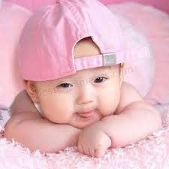
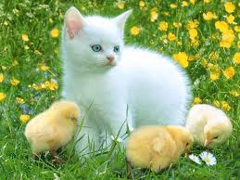
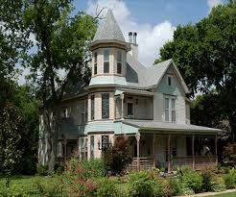
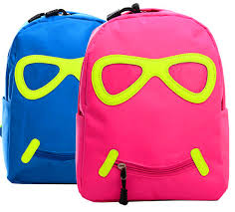
nouns

Slide 2
So nouns are names………………….
Everything we can see or talk about is represented by a word that names it. That "naming word" is called a noun.
Sometimes a noun will be the name for something we can touch (e.g., lion, cake, computer), and sometimes a noun will be the name for something we cannot touch (e.g., bravery, mile, joy).

Slide 3
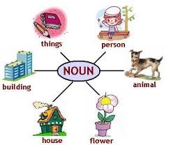

Slide 4
The Two Main Noun Categories: Common Nouns and Proper Nouns
A common noun is the word used for a class of person, place, or thing (e.g., person, city, dog).
A proper noun is the given name of a person, place or thing, i.e., its own name (e.g., Michael, New York, Rover).
A proper noun always starts with a capital letter.

Slide 5
Beside them the Types of nouns :-
Abstract Nouns
things you cannot see or touch. For example:
bravery
joy
determination
Collective Nouns
words that denote groups. For example:
team
choir
pack

Slide 6

Concrete nouns
things you can see or touch. For example:
tree
hammer
cloud

Slide 7
Let’s review!
NOUN-NAME, PLACE, ANIMAL THING
Common noun : Eg. –lawnmower,dictionary
Proper noun : eg. - World war II,
Harry Potter, Saturday, July, Australia
Collective noun : eg. -a family, A crowd of people, a loaf of bread
Abstract noun : eg. - wisdom, sleep
Concrete nouns : eg. - building , iron steel, gold

